Slide 1
6. Neighbor Classification
For automatic classification, there are two basic methods, one is dividing the feature space into different discriminant domains by using discriminant function, as the non-linear discriminant function method.
The other is known as template matching method, where the testing samples are matched with all training samples to determinate their types.
Neighbor classification is such a template matching method.

Slide 2
6. Neighbor Classification
The step of neighbor classification is:
  Each training sample is first considered as a template;
  Each testing sample is compared with each template to search which template is the most similar one (minimum);
  The type of each testing sample is the one which is the most similar.

Slide 3
6. Neighbor Classification
For example, class A contains 10 training samples, so there are ? Templates.
Class B class contains eight training samples, there are ? templates.

Slide 4
6. Neighbor Classification
There are several neighbor classification methods:
  Nearest neighbor classification method;
  k-nearest neighbor classification method;
  Improved neighbor classification method.

Slide 5
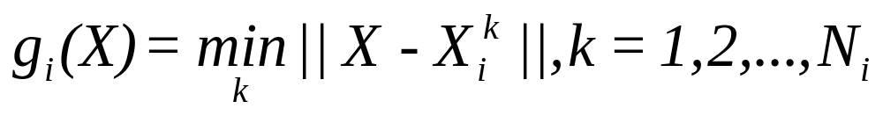
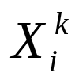
6.1 Nearest Neighbor Classification
If the most similarity rule is the smallest distance, the neighbor classification method is called the nearest neighbor method.
If there are C classes, and each class contains N samples, then the discriminant function of the i^{th} class is:
where is the k^{th} sample in the i^{th} class.

Slide 6
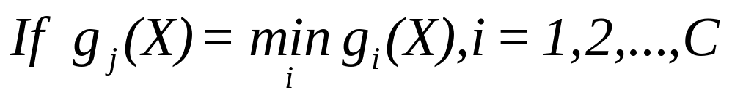
6.1 Nearest Neighbor Classification
The discriminant rule is:
Then the testing sample belongs to the j^{th} class.

Slide 7
6.1 Nearest Neighbor Classification
The step of nearest neighbor classification is:
  Considering each training sample as a template;
  Computing the distance between the testing sample and each template;
  Searching the minimum in all the distance;
  Assigning the type of the minimum to the testing sample.

Slide 8
6.1 Nearest Neighbor Classification
If the information of the training samples T and the testing sample x(0.2 0.2) are described as follows respectively:
Sample No. | 1 2 3 | 1 2 3 | 1 2 3
Feature 1 | 0.2 0.4 0.2 | 0.2 0.2 0.2 | 0 0 0.5
Feature 2 | 0.1 0.2 0.5 | 0.4 0.4 0.4 | 0.2 0.2 0.2
Class | 1 | 2 | 3
Try to determinate the type of x using the nearest neighbor method.

Slide 9
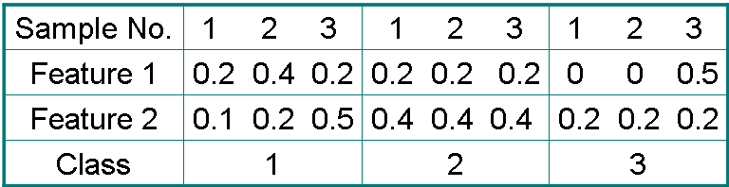
The first step: Each training sample is first considered as a template.

Slide 10
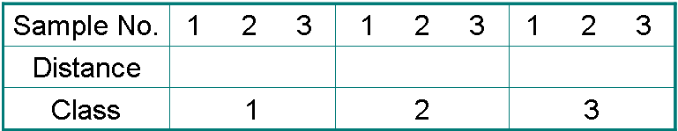
The second step: Computing the distance between the testing sample and each template
x(0.2 0.2)

Slide 11
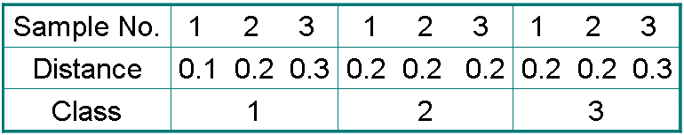
The third step: Searching the minimum in all the distance

Slide 12
The fourth step: Assigning the type of the minimum to the testing sample

Slide 13
6. Neighbor Classification
There are several neighbor classification methods:
  Nearest neighbor classification method;
  k-nearest neighbor classification method;
  Improved neighbor classification method.

Slide 14
6.2 k-nearest neighbor classification method
K-nearest neighbor method is the expanded form of nearest neighbor method.

Slide 15
6.2 k-nearest neighbor classification method
The step of neighbor classification is:
  Considering each training sample as a template;
  Computing the distance between the testing sample and each template;
  Counting the number of minimum for each class N_{i}, i = 1,2, ..., m;
  Assigning the type of the maximum K_{i} to the testing sample.

Slide 16
6.2 k-nearest neighbor classification method
If the information of the training samples T and the testing sample x(0.2 0.2) are described as follows respectively:
Sample No. | 1 2 3 | 1 2 3 | 1 2 3
Feature 1 | 0.2 0.4 0.2 | 0.2 0.2 0.2 | 0 0 0.5
Feature 2 | 0.1 0.2 0.5 | 0.4 0.4 0.4 | 0.2 0.2 0.2
Class | 1 | 2 | 3
Try to determinate the type of x using the k-nearest neighbor method.

Slide 17
The first step: Each training sample is first considered as a template.

Slide 18
The second step: Computing the distance between the testing sample and each template
x(0.2 0.2)

Slide 19
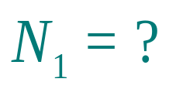
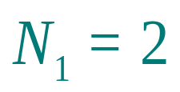
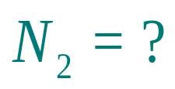
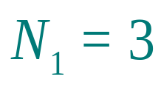
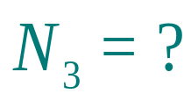
The third step: Counting the number of minimum for each class N_{i}, i = 1,2, ..., m
  Here we count the number of minimum=0.2 for each class K_{i}, i = 1,2, 3

Slide 20
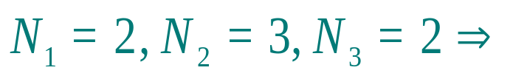

The fourth step: Assigning the type of the maximum K_{i} to the testing sample.

Slide 21
6. Neighbor Classification
There are several neighbor classification methods:
  Nearest neighbor classification method;
  k-nearest neighbor classification method;
  Improved neighbor classification method.

Slide 22
6.3 Improved neighbor classification method
Quick Search neighbor method
Clip neighbor method
Compressed neighbor method

Slide 23
6.3.1 Quick Search neighbor method
The basic idea of quick search neighbor method is described as follows:
The sample set is divided into subsets according to the nearest neighbor, and the maximum distance from the subset samples to its corresponding centroid are given;
These subsets can be further decomposed to form a hierarchical structure, so the tested samples can gradually deepen the scope of searching the nearest neighbor from a subset to a smaller subset and determine its nearest neighbor.

Slide 24
6.3.1 Quick Search neighbor method
The basic step of quick search neighbor method contains the following components:
Subset division;
Determine whether the nearest neighbor of a test sample x is on a subset of a node;
Classification of test samples.

Slide 25
6.3 Improved neighbor classification method
Quick Search neighbor method
Clip neighbor method
Compressed neighbor method

Slide 26
6.3.2 Clip neighbor method
The basic idea of clip neighbor method: the classification error mainly comes from the samples of different categories in the overlapping area.

Slide 27
6.3.2 Clip neighbor method
The basic step of clip neighbor method contains the following two components:
The samples in the training set are used for pre classification, the misclassified samples are cliped, and the remaining samples construct the cliped sample set;
The tested samples are classified by the cliped sample set and the nearest neighbor rule.

Slide 28
The setp of the clip set construction contains the following components:
The sample set X is randomly divided into multiple subsets X={X₁, X₂,..., X_{S}};
The nearest neighbor method is used to classify the set X_{i} with X_{(i + 1)} as the reference set;
Remove the samples wrongly classified in step (2);
Use all the remaining samples to form a new sample set;
Repeat (1)-(4) until there are no misclassified samples.

Slide 29
6.3 Improved neighbor classification method
Quick Search neighbor method
Clip neighbor method
Compressed neighbor method

Slide 30
6.3.3 Compressed neighbor method
The basic idea of the compressed neighbor method is:
Use the existing sample set to gradually generate a new sample set, and the newly generated sample set can correctly classify the original sample set with the nearest neighbor method under the condition of keeping the minimum number of samples;
Then the newly generated sample set will classify the input samples and maintain a high recognition rate.

Slide 31
6.3.3 Compressed neighbor method
The basic step of compressed neighbor method contains the following two components:
Initialization: Orig is a sample set and Store is an empty set. Select any a sample from Orig and put it into the Store as the first sample of the new sample set;

Slide 32
The basic step of compressed neighbor method contains the following two components:
Initialization
New sample set generation: use the Store sample set to classify the i-th sample selected from the Origin sample set according to the nearest neighbor method: if the classification reslut is wrong, then put the sample into the Store sample set; if the classification reslut is correct, then put the sample back into the Origin sample set.

Slide 33
The basic step of compressed neighbor method contains the following two components:
Initialization
New sample set generation
End of process: Repeat the second step until no more samples are put into the Store sample set, or the Origin sample set has become an empty set.

Slide 34
Homework
For example, class A contains 15 training samples, so there are ? Templates.
Class B class contains 38 training samples, there are ? templates.

Slide 35
Homework
If the distance between the testing sample and the first training samples is (0.1，02，0.3), the distance between the testing sample and the second training samples is(0.2，0.2，0.2).
Then which category does the testing sample belong to based on nearest neighbor method and K-nearest neighbor method?

Slide 36
Homework
If the information of the training samples T and the testing sample x(0.2 0.2) are described as follows respectively:
Sample No. | 1 2 3 4 5 | 1 2 3 4
Feature 1 | 0.2 0.4 0.2 0.2 0.5 | 0 0.2 0.2 0.4
Feature 2 | 0.1 0.2 0.5 0.4 0.2 | 0.2 0 0.4 0.2
Class | 1 | 2
Try to determinate the type of x using the nearest neighbor method and the K- nearest neighbor method.

